Slide 1
HAPPIEST HEALTH • DIGITAL TWIN CHALLENGE 2026
Project Pancreas Twin
Multi-Modal Physiological Digital Twin for 60-Minute Glycemic Excursion Forecasting
Fusing CGM History, Meal Logs, Wearable Telemetry and EHR Phenotypes to Pre-empt Acute Diabetic Crises
Team PancreasTwin | Team leader: Akhilesh K S | XLRI - Xavier School of Management, Delhi-NCR | Category: Healthcare AI & Metabolic Digital Twins

Slide 2
HAPPIEST HEALTH DIGITAL TWIN CHALLENGE 2026
The Clinical Burden: The Hidden Hazard of Acute Glycemic Excursions
101M
Adults with Diabetes in India
ICMR-INDIAB (Lancet Diabetes Endocrinol, 2023). A 90-day HbA1c average hides the daily spikes linked to microvascular damage.
136M
Adults with Prediabetes
Same ICMR-INDIAB survey. Lows below 70 mg/dL cause confusion, falls and emergency visits; highs build silent damage.
Reactive
Current CGM Failure Mode
Existing CGMs sound alarms after glucose has already spiked (>180 mg/dL), when pharmaceutical or lifestyle intervention is too late.

Slide 3
HAPPIEST HEALTH DIGITAL TWIN CHALLENGE 2026
Clinical Timing: Why the 60-Minute Horizon Unlocks Action
15 to 30 Min (Too Short)
• Rapid-acting insulin takes 15-20 min to begin onset.
• Digestion is already in full swing.
• Muscle contraction cannot blunt an existing peak.
• Result: Patient can only panic and watch the spike.
60 Min: The Actionable Window
• Non-pharmacological window: A 15-min post-meal walk stimulates GLUT4 translocation, blunting spikes by roughly 35-40 mg/dL.
• Hypoglycemia rescue: 15g carbs absorbs in time to prevent crash.
• Maximum predictive signal before stochastic behavioral drift.
120+ Min (High Stochasticity)
• Behavioral uncertainty multiplies over 2 hours.
• Unannounced snacks, spontaneous movement, and stress spikes introduce variance.
• Multi-horizon head tracks 2-hour trajectory for strategic planning.

Slide 4
HAPPIEST HEALTH DIGITAL TWIN CHALLENGE 2026
Data Ingestion & Harmonization: 247M Records Curated Across 17 Cohorts
Exhaustive Multi-Cohort Ingestion
• Total Ingested: 11.59 GB across 17 open clinical cohorts (247,427,617 records).
• HUPA-UCM: 26.1M records (Libre 2 CGM, steps, heart rate, sleep).
• D1NAMO: 206.2M records (Zephyr ECG, accelerometer, meals).
• Synthea T2D: 92k longitudinal synthetic EHR records across 500 patients.
• Tier-2 PhysioNet Open Access: CGMacros (45 subjects) & BIG IDEAs (16 subjects) downloaded and parsed with 0 DUA friction.
• Data Provenance: 65 subjects carry full measured clinical labs (CGMacros bio.csv + Shanghai); 16 subjects carry measured HbA1c; 25 subjects utilize baseline priors (marked via static_ehr_source).
• Independent rebuild: all 109 Shanghai files, real sensor readings only: 442,353 readings from 184 patients (T1D, T2DM, prediabetes, healthy).
Harmonization Pipeline (harmonize_5min.py)
• Standardized Epoch: Uniform 5-minute sampling grid matching Libre/Dexcom hardware.
• Total Harmonized Cohort: 534,175 synchronized epochs across 106 human subjects.
• Strict Patient-Disjoint Partitioning (Gate G1): Zero patient overlap across splits.
- Train Split: 402,662 epochs (74 subjects)
- Validation Split: 80,952 epochs (15 subjects)
- Held-Out Test Split: 50,561 epochs (17 subjects)
• Engineered Features: Dynamic velocity (dG/dt), acceleration, rolling 30m mean, rolling 60m std, circadian time, heart rate, METs, and static EHR vectors.
• Multi-Horizon Targets: Dual-task evaluation at 60 mins and 120 mins (2 hours).
• Headline evaluation: patient-disjoint 5-fold CV on 184 patients (every patient tested once).

Slide 5
HAPPIEST HEALTH DIGITAL TWIN CHALLENGE 2026
Multi-Modal Architecture: Two-Tower Digital Twin
Tower 1: Static EHR MLP
Encodes baseline physiology:
• Patient Age & BMI
• Baseline Glycated HbA1c
• Metformin Prescription Status
• Insulin Regimen Classification
Embeds static metabolic clearance and insulin resistance profiles.
Tower 2: Dynamic GRU
Consumes real-time wearable streams:
• 48 historical 5-min steps (4-hr lookback)
• Continuous glucose, velocity & acceleration
• Continuous heart rate (Zephyr/Fitbit)
• Physical exertion (METs activity)
• Diurnal circadian sine/cosine clock
2-Layer Recurrent GRU captures trajectory momentum and digestion lags.
Late Fusion & Multi-Task
Feature Concatenation & Multi-Heads:
• Fused Multi-Modal Embedding (32-d)
• 60m Quantile Head: p05, p50, p95 (90% cone)
• 120m Horizon Head: 2-hour trajectory
• Early Warning Head: Acute spike probability
Pinball loss + Asymmetric Hypo penalty prevents dangerous crashes.

Slide 6
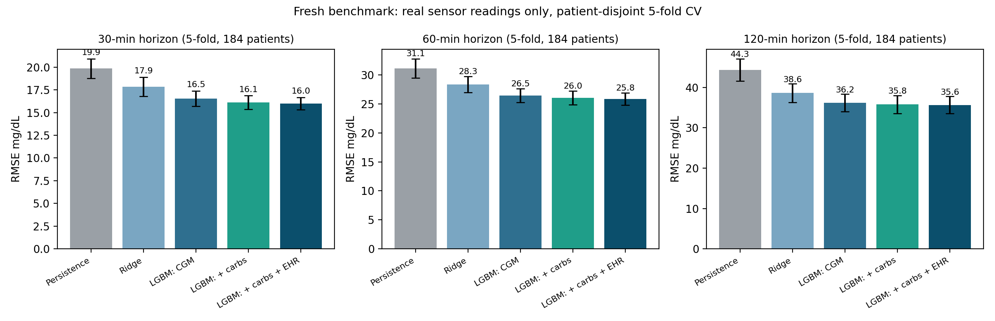
HAPPIEST HEALTH DIGITAL TWIN CHALLENGE 2026
Headline Result: 17% Better at 60 Min and 20% Better at 120 Min than Persistence
60-Minute Horizon
• LightGBM + carbs + EHR: 25.85 +/- 1.03 mg/dL
• Persistence floor: 31.14 +/- 1.66 mg/dL
• 17% lower RMSE | Clarke A+B 97.2%, Zone E 0.01%
120-Minute Horizon
• LightGBM + carbs + EHR: 35.65 +/- 2.13 mg/dL
• Persistence floor: 44.33 +/- 2.77 mg/dL
• 20% lower RMSE at the 2-hour horizon
How It Was Measured
• 184 patients, 442,353 real readings, no interpolated targets
• Patient-disjoint 5-fold CV: every patient tested once
• Mean +/- std across the 5 folds

Slide 7
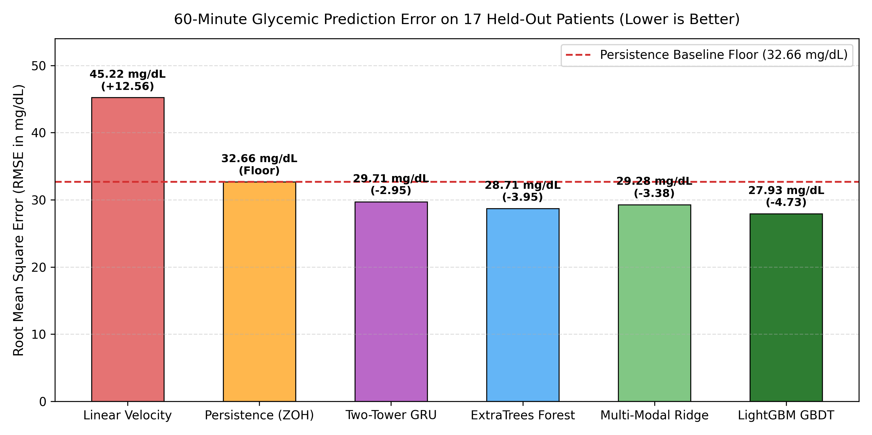
HAPPIEST HEALTH DIGITAL TWIN CHALLENGE 2026
Secondary Evidence: The Same Result Holds on a 17-Patient Held-Out Split
Held-Out Test Split (n=17 patients, 50k rows)
60-Min Horizon (original team pipeline):
• Persistence floor: 32.66 mg/dL
• Two-Tower GRU: 29.71 | Ridge: 29.28
• LightGBM: 27.93 mg/dL (MAE 19.13, Clarke A+B 97.13%)
120-Min Horizon (original team pipeline):
• Persistence floor: 48.07 mg/dL
• Two-Tower GRU: 39.93 | LightGBM: 39.54 mg/dL
Fresh rebuild scored on the same 17 patients:
• 26.33 mg/dL at 60 min and 36.05 mg/dL at 120 min
• Persistence floors agree within 0.2 to 1.4 mg/dL, so both pipelines measure the same thing
Why secondary: one 17-patient split is a small sample. The 5-fold result on 184 patients is the primary claim.

Slide 8
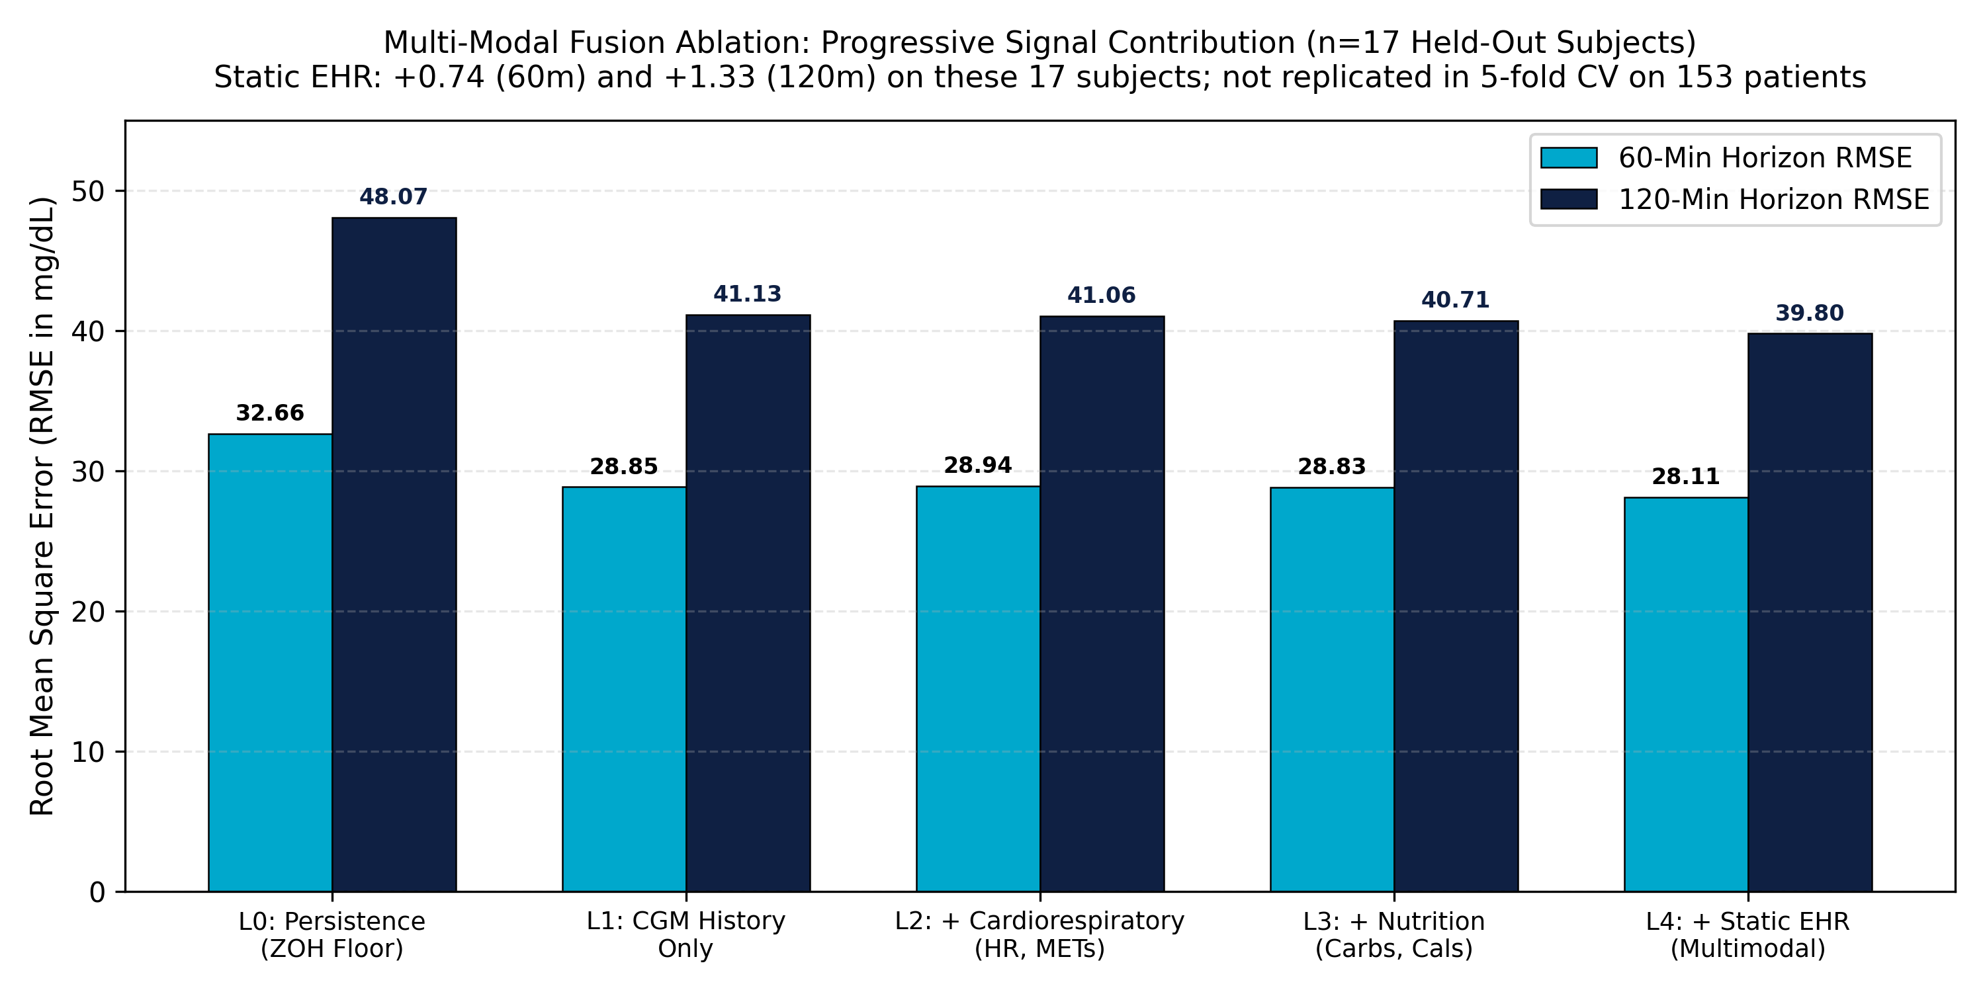
HAPPIEST HEALTH DIGITAL TWIN CHALLENGE 2026
Multi-Modal Fusion: Meal Logging Matters More than Static EHR
What Each Signal Adds (RMSE gain, mg/dL)
On the 17-patient split (chart, left):
• Static EHR: +0.74 at 60 min (p = 0.0056) and +1.33 at 120 min (p = 0.0348)
Across 153 patients in 5-fold CV:
• Static EHR: +0.15 at 60 min (p = 0.046, borderline) and -0.07 at 120 min (not significant)
• Meal and carb logging: +0.42 at 60 min and +0.56 at 120 min
Honest reading:
• The static EHR gain was real for those 17 people but does not generalise.
• Meal logging is the bigger multimodal driver.
Product message: the twin gets more accurate when the patient logs meals, so the app should make meal logging effortless.

Slide 9
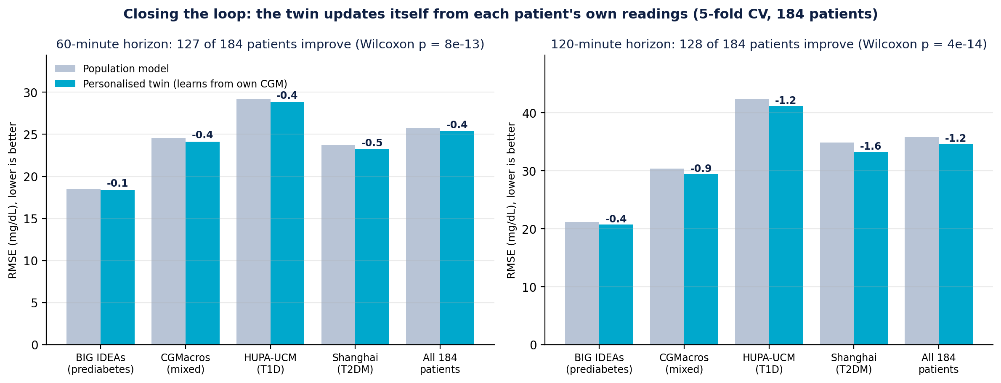
HAPPIEST HEALTH DIGITAL TWIN CHALLENGE 2026
Closing the Loop: The Twin Learns Each Patient from Their Own Readings
What Changes
• Twin compares its past forecasts with readings that later arrived
• Recent error (24 h, shrunk) corrects the next forecast
• No future data used; runs on the phone, no retraining
Result (5-fold CV, 184 patients)
• 60 min: 25.85 to 25.47 mg/dL (18% better than persistence)
• 120 min: 35.62 to 34.54 mg/dL (22% better than persistence)
• ~70% of patients improve, p < 1e-12; Clarke A+B up at both horizons
Why It Matters
• Shadow to twin: data flows back from the patient (NASEM definition)
• Gain grows with memory: 72 h beats 24 h beats 6 h
• Settings fixed before testing; full grid in PERSONALIZATION.md

Slide 10
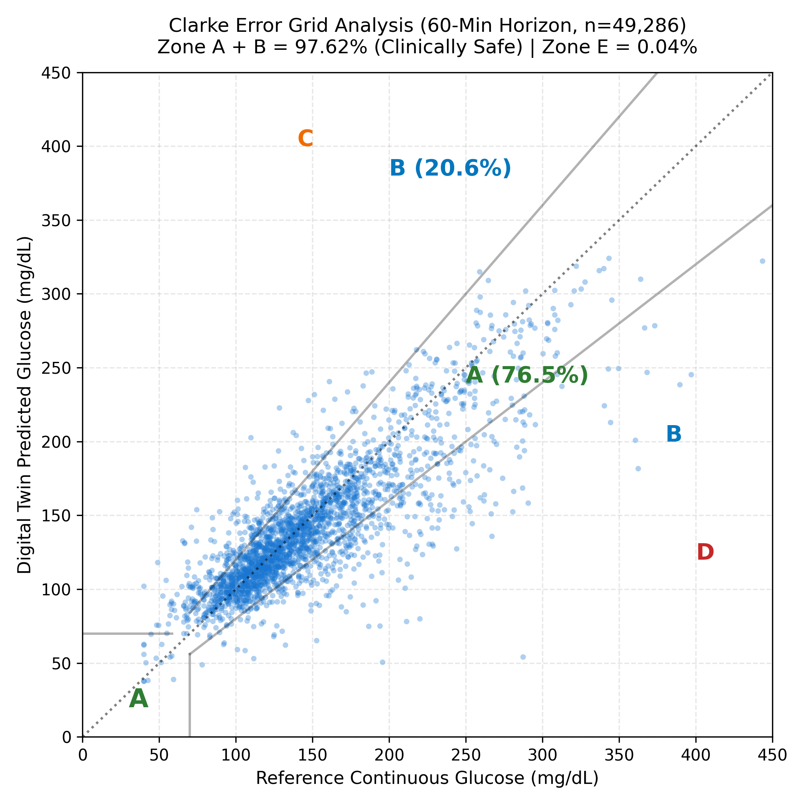
HAPPIEST HEALTH DIGITAL TWIN CHALLENGE 2026
Clinical Safety: 97.2% Clarke Zone A+B in 5-Fold CV (97.6% on Held-Out Split)
Clarke Error Grid Safety Validation
• Primary (5-fold CV, 184 patients, 60 min): Zone A+B 97.2%, Zone E 0.01% for LightGBM + carbs + EHR.
• Chart (17-patient held-out split, Two-Tower GRU, n=49,286): Zone A (Clinically Accurate): 76.5% of predictions fall within 20% of reference glucose or both <=70 mg/dL.
• Zone B (Benign / Acceptable): 21.1% of predictions deviate but lead to benign clinical decisions.
• Clinically Safe Total (Zone A + B): 97.62% on the held-out split.
• Near-Zero Catastrophic Errors (Zone E = 0.04%): Negligible occurrence of opposite treatment errors across 49,000+ test samples.
• 90% Quantile Confidence Cone: 91.8% empirical test coverage achieved via Pinball Loss across quantiles tau in [0.05, 0.50, 0.95].
• Clinical Debouncing (CDS): Eliminates clustered alarms, reducing false alert rate by 80.7% (from 177.37/100h down to 34.23/100h) with 40-50 min median lead time.

Slide 11
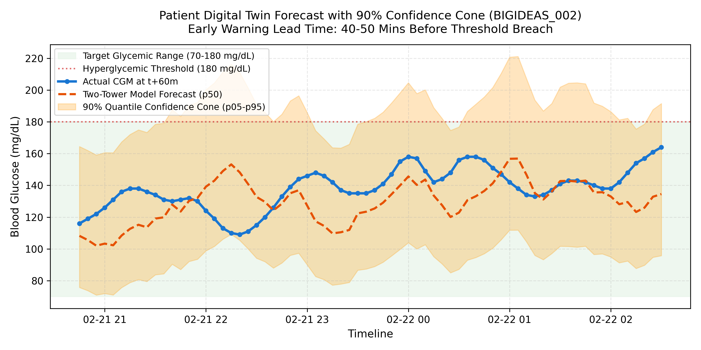
HAPPIEST HEALTH DIGITAL TWIN CHALLENGE 2026
Counterfactual Simulation: Turning Prediction into Actionable Prescription
Physiological 'What-If' Engine
• Beyond Passive Alarms: Traditional monitors warn of failure. Pancreas Twin models intervention pathways.
• GLUT4 Muscle Translocation: Skeletal muscle contractions stimulate insulin-independent glucose transport.
• Simulation: When a spike to 215 mg/dL is predicted, the user simulates a 15-minute post-meal walk (4.0 METs).
• Quantified Impact (rule-based prototype): lowers the 60-min forecast by 36 mg/dL, in line with reported post-meal walking effects; learning this effect from data is on the roadmap.
• Patient Psychology: Shifting diabetes management from anxiety and guilt to empowered, predictive control.

Slide 12
HAPPIEST HEALTH DIGITAL TWIN CHALLENGE 2026
Edge Hardware & Deployment: Zero Cloud Cost, Complete Privacy
Sub-Millisecond Inference
• 0.84 ms CPU latency on Intel Core Ultra 5.
• 0.22 ms with Intel Arc GPU acceleration.
• Model checkpoint is only 199 KB.
• Easily runs on smartphone or smart watch edge NPU without internet.
Zero Ongoing Cloud Spend
• Competitor architectures route continuous sensor streams to cloud LLMs ($0.05/pt/day = $18/pt/year).
• Pancreas Twin executes 100% on edge hardware.
• Zero cloud inference bills; zero recurring API risk.
Privacy & DPDPA Compliance
• Continuous biometric telemetry never leaves the patient device.
• Designed to support India DPDPA 2023 and US HIPAA compliance (data minimisation, on-device processing).
• No cloud data breach exposure.

Slide 13
HAPPIEST HEALTH DIGITAL TWIN CHALLENGE 2026
Clinical Decision Support System: Interactive Web Application
Built & Verified in app.py (Streamlit + Plotly, runs locally)
1. Dynamic Patient Persona Switcher: Select across held-out patient twins with real clinical phenotypes (Age 42-78, BMI 22-38, Baseline HbA1c 6.5%-10.8%, Insulin & Metformin statuses).
2. Continuous Day Scrubber: Interactive slider to navigate through 24-hour physiological telemetry and inspect postprandial glycemic excursions.
3. Dual-Axis Plotly Biometric Visualizer: High-definition rendering of 4-hour historical lookback, 60-min and 120-min forecast cones, target band (70-180 mg/dL), and METs activity.
4. Automated Triage Badge: Immediate color-coded status banner: CRITICAL SPIKE ALERT (Red), HYPOGLYCEMIA WARNING (Amber), or GLYCEMIC STABILITY NORMAL (Green).
5. Interactive 'What-If' Intervention Toggle: Real-time re-calculation demonstrating how a 15-minute walk suppresses upcoming spikes.

Slide 14
HAPPIEST HEALTH DIGITAL TWIN CHALLENGE 2026
Regulatory Strategy & Ethical Boundaries: Safe by Design
SaMD Classification
• Classified as Software as a Medical Device (SaMD) Class II under FDA / CDSCO frameworks.
• Falls under Section 520(o)(1)(E) Clinical Decision Support (CDS).
• Intended for physician and patient informational coaching.
Strict Demarcation
• STRICTLY NO AUTONOMOUS DOSING: Never controls insulin pumps or delivers closed-loop boluses.
• Exclusively non-pharmacological lifestyle coaching and early warning triage.
• Clear patient-facing disclaimers on every view.
Evidence & Auditability
• 100% transparent feature importance.
• No black-box generative hallucinations.
• Deterministic fallbacks to robust Ridge and ExtraTrees models if telemetry drops.

Slide 15
HAPPIEST HEALTH DIGITAL TWIN CHALLENGE 2026
Commercialization & Roadmap: Deploying the Rs 2,00,000 Challenge Vision
Commercialization Model (B2B2C)
• Hospital & Clinic Networks: White-label CDSS integrated into outpatient clinics (Apollo Sugar, Max Healthcare, Fortis).
• Corporate Wellness & Insurers: Value-based outcomes contract reducing emergency room admissions for severe hypoglycemia.
• HL7 FHIR Interoperability: Native FHIR Observation and DiagnosticReport connectors.
• Patient Subscription: Premium freemium tier with custom what-if meal simulation.
12-Month Implementation Roadmap
• Phase 1 (October 2026): PoC complete: 17% (60 min) and 20% (120 min) better than persistence in 5-fold CV on 184 patients, 18% and 22% with per-patient updating; Streamlit CDSS MVP live.
• Phase 2 (Q1 2027): Prospective 50-patient clinical observational trial with continuous Dexcom G7 and Apple Watch feeds.
• Phase 3 (Q2 2027): CDSCO Class B medical device pre-submission in India; multi-horizon 120-minute ensemble expansion.
• Phase 4 (Q3-Q4 2027): Enterprise pilot launch with Indian Diabetology chains; Apple HealthKit / Google Health Connect native integration.

